Slide 1
Excel
Formulas & Function
Logical
Maths
Text

Slide 2
Entering a Formula
A formula is an expression that returns a value
A formula is written using operators that combine different values, returning a single value that is then displayed in the cell
  The most commonly used operators are arithmetic operators
The order of precedence is a set of predefined rules used to determine the sequence in which operators are applied in a calculation

Slide 3
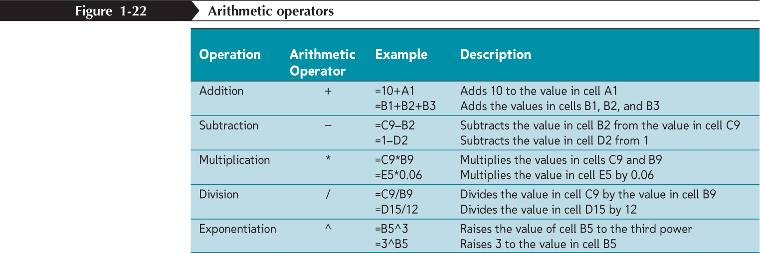
Entering a Formula

Slide 4
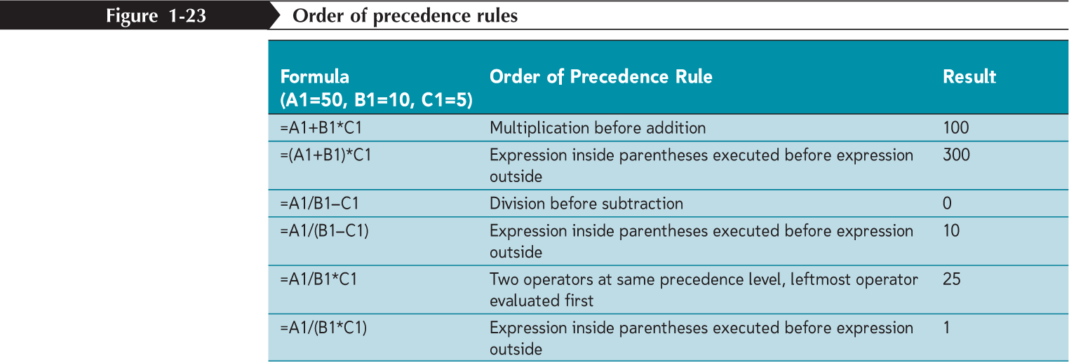
Entering a Formula

Slide 5
Entering a Formula
Click the cell in which you want the formula results to appear
Type = and an expression that calculates a value using cell references and arithmetic operators
Press the Enter key or press the Tab key to complete the formula

Slide 6
Logical Formula’s
-IF
The IF function tests to see if a certain condition in a spreadsheet is true or false.
=IF ( logical_test, value_if_true, value_if_false )
= IF ( D1 < 26 , 100 , 200 )
-Enter 35 into cell D1.
-Click on cell E1 - the location where the results will be displayed.
-Click on the Formulas tab.
-Choose Logical Functions from the ribbon to open the drop down list.
-Click on IF in the list to bring up the function's dialog box.
-On the Logical_test line in the dialog box, click on cell D1. After this type the less than symbol ( < ) and then the number 26.
-On the Value_if_true line of the dialog box, type 100.
-On the Value_if_false line of the dialog box, type 200.
-Click OK.
-The value 200 should appear in cell E1, since the value in D1 is greater than 26.

Slide 7
Logical Formula’s
-AND
The AND function is one of Excel’s Logical Functions. Like most logical functions, the output from the AND function is either the word TRUE or FALSE.
=AND (B1>100, B2>100, B3>100)
If all three of these cells (B1,B2, and B3) contain a value greater than 100, the output for the AND function in cell C1 will be TRUE. If any of these cells have numbers less than or equal to 100, the output for the AND function will be FALSE.
By itself, the AND function has limited usefulness. By combining it with another function, such as the IF function, the AND function can increase the capabilities of your spreadsheet.
=IF(AND(B1>100,B2>100,B3>100),”Over Budget”,”Acceptable”)

Slide 8
Logical Formula’s
-OR
The OR function is one of Excel's Logical Functions. Like most logical functions, the output from the OR function is either the word TRUE or FALSE.
=OR (B1>100, B2>100, B3>100)
If any of these three cells (B1,B2, or B3) contains a value greater than 100, the output for the OR function in cell C1 will be TRUE. If all three cells have numbers less than or equal to 100, the output for the OR function will be FALSE.
By itself, the OR function has limited usefulness. By combining it with another function, such as the If Function, the OR function can increase the capabilities of your spreadsheet.
=IF(OR(B1>100,B2>100,B3>100),”Over Budget”,”Acceptable”)

Slide 9
Text Formula’s
-CONCATINATE
The CONCATENATE function joins up to 255 text strings into one text string. The joined items can be text, numbers
=CONCATENATE(A1," ",B1)
The second argument in this example (" ") is a space character. You must specify any spaces or punctuation that you want to appear in the results as an argument that is enclosed in quotation marks.
You can also use the ampersand (&) calculation operator instead of the CONCATENATE function to join text items. For example, =A1 & B1 returns the same value as =CONCATENATE(A1, B1).

Slide 10
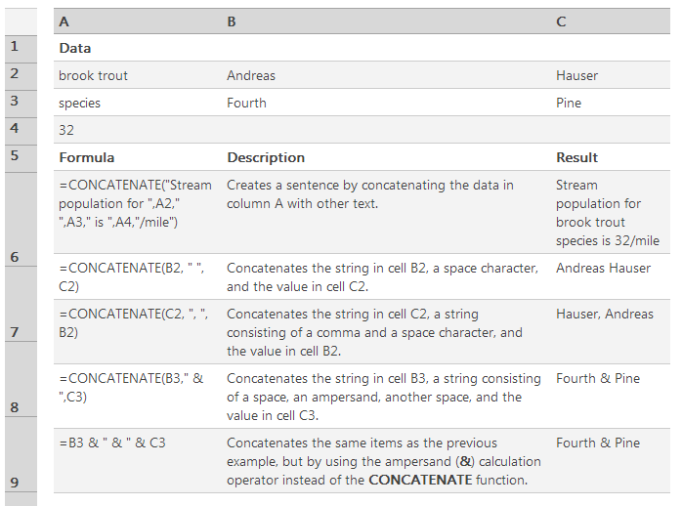
Text Formula’s

Slide 11
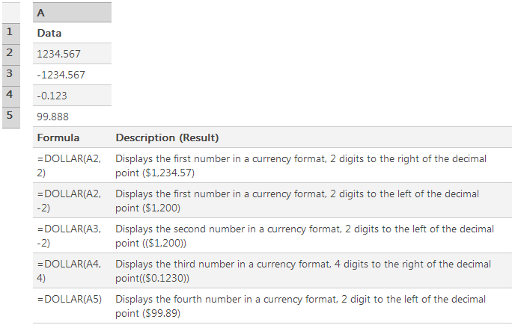
Text Formula’s
-DOLLAR
The function described in this Help topic converts a number to text format and applies a currency symbol. The name of the function (and the symbol that it applies) depends upon your language settings.
=DOLLAR(number,decimals)

Slide 12
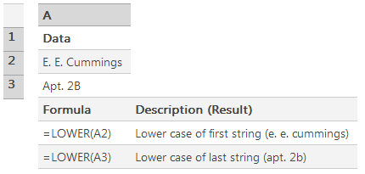
Text Formula’s
-LOWER
Converts all uppercase letters in a text string to lowercase.
=LOWER(text)

Slide 13
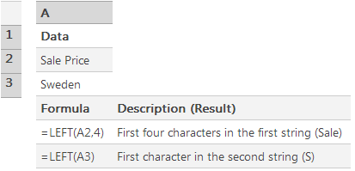
Text Formula’s
-LEFT
LEFT returns the first character or characters in a text string, based on the number of characters you specify.
=LEFT(text,num_chars)

Slide 14
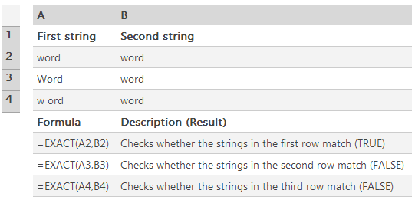
Text Formula’s
-EXACT
Compares two text strings and returns TRUE if they are exactly the same, FALSE otherwise. EXACT is case-sensitive but ignores formatting differences. Use EXACT to test text being entered into a document.

Slide 15
Copying and Pasting Formulas
With formulas, however, Excel adjusts the formula’s cell references to reflect the new location of the formula in the worksheet

Slide 16
Introducing Functions
A function is a named operation that returns a value
For example, to add the values in the range A1:A10, you could enter the following long formula:
=A1+A2+A3+A4+A5+A6+A7+A8+A9+A10
Or, you could use the SUM function to accomplish the same thing:
=SUM(A1:A10)

Slide 17
Entering Functions with AutoSum
The AutoSum button quickly inserts Excel functions that summarize all the values in a column or row using a single statistic
  Sum of the values in the column or row
  Average value in the column or row
  Total count of numeric values in the column or row
  Minimum value in the column or row
  Maximum value in the column or row

Slide 18
Thank You

